Slide 1

Leslie the AI Butler
developed by:
💯💯💯💯💯💯💯💯💯💯💯💯💯200💯💯💯💯💯💯💯💯💯💯💯💯200💯💯💯💯💯💯💯💯200💯💯💯💯💯💯💯💯💯💯💯💯💯💯💯
Notes:
Smidge

Slide 2

What is Leslie?
Notes:
Jokey question

Slide 3

What isn’t Leslie?
Notes:
Punchline

Slide 4
What is Leslie?
An AI Butler who can:
  Cook
  Clean
  Knock Your Socks Off
Brainy-Smart Technology
  No Flaws
  Can Complete Any task
Notes:
Leslie is an AI Butler that can do pretty much anything you want it to do, provided what you want it to do is massively improve your life in every way imaginable. He can cook, he can clean, he can quite literally knock your socks off (if you wanted him to) and he’s always at your beck and call.
The Artificial Intelligence was developed using special BS (brainy smart) technology. And has absolutely no flaws or exploitable weaknesses. Yes, really. The only slight error we concede is that there aren’t more of them but we’re planning to have a factory where other Leslies produce more Leslies and that can really only end well.

Slide 5

What Can Leslie Do for You?
Back Scratching
Dispatching Intruders
Drawing Blueprints
Welding Without Personal Risk
Childminding
Making Breakfast
Golf Club Transportation
Presidential Activities
Gym Safety
Personal Training
Choral Duties
Line Holding
Notes:
From scratching your back to dispatching intruders and so much more, Leslie was designed with complete bespoke customization in mind.
For engineers, Leslie can be applied in a range of ways from drawing up blueprints to pristine welding at no risk to yourself or your body.
For housewives, Leslie can mind the kids or make the breakfast, giving you more time to focus on yourself.
For golfers, do you need a caddy or someone to just run America for you while you’re out on the green? We’ve got you covered; and we know you can afford it.
Meatheads will always have someone to spot them at the gym and, for the weaklings, a personal trainer to get them started on their fitness journey.
Priests can use Leslie as a choir boy.
For scalpers, Leslie can reserve your place in hell.
We could go on. We won’t… but we could. The point is that there is something for everyone with Leslie, and what he can do for you is limited pretty much exclusively by your imagination.

Slide 6

(https://youtu.be/Hu-JpmXrQGo)

Slide 7

Military Applications
Versatile and adaptable to fill any position.
Strategy Optimisation:
  Always annihilate your opponent;
  Presented in an understandable format.
Expendable.
Always follows orders.
Impenetrable armour.
I want a leslie in my ranks
Notes:
If your enemies are really mean... then get Leslie to destroy all your enemies for you.From a foot soldier to an army general, Leslie can be it all.
Leslie would be able to plan out the perfect strategy for you to annihilate your opponents for you using the best strategy possible. Why rely on something that can end up in failure due to human error, when you can always win and expand your territory with Leslie. Leslie can tell you all of the possible options you could take to ensure that you win the battle.
Leslie could also be on the battlefield turning the tide of war in your favour. Leslie would have no problem taking care of your enemies for you. All you would to do is tell Leslie what to do and he will do it without any problems. A normal Leslie bot is equipped with an impregnable armour that even tanks will have trouble getting through. So what are you waiting for, buy one now and say goodbye to all your enemies.

Slide 8
Parental Applications
Able to look after your children
  Entertainment options
  Education option
Errand completion
  Complete shopping
  Able to order anything online for you
Notes:
Kids being too much of a hassle for you. Take some time off and relax while Leslie will tend to all of your child's needs and wants. Leslie will be able to keep your child satisfied while you are out enjoying yourself, taking a well earned break.
Leslie will also be able to do all of the errands that you yourself would do unwillingly. Leslie is here to satisfy all your needs as a parent and more. An example of a task that Leslie would be able to do is go out shopping while you are at home looking after your children.Why have someone else do it when there is a chance they could mess up and buy the wrong things when there is Leslie who is the perfect robot and will always buy the right thing for you.
Leslie is there to be a helping hand and will always be there for you if you in your time of need.

Slide 9
Healthcare Applications
Complete Surgeries
  Less risk to the patient as Leslie is perfect every time.
Prescribe remedies
Can identify illnesses
  Able to provide solutions to return patients to full health.
Can care compassionately
Notes:
This is an industry where anything near perfection is needed to ensure things run smoothly and perfection can be guaranteed with Leslie. The AI robot is capable of doing anything from surgeries to giving out prescriptions. Leslie would be very useful in this field to carry out procedures which are very delicate such as spinal surgery or heart surgery. These procedures are very risky but be assured that Leslie can do these procedures without making mistakes.
Leslie is also able to identify the nature of one’s illness very quickly due to it’s large knowledge base. Leslie will also come with a solution or procedure to rectify the problem of the individual immediately. Leslie is a robot that is that is emotionally intelligent and aware and because of this Leslie will be able to nurse a hospitalized patient properly.
If you are looking for perfection in healthcare, Leslie is the one to turn to.

Slide 10
Challenges and their solutions
Challenges to Deliver
Time Frame
  Too many subsections
(Need a large team)
  Too much data access needed
(Get promotion from larger companies)
Computing is not yet advanced enough
  Processing power is still limited
(Provide specific models only)
  Size required for Leslie is larger than the proposed model.
(Use an external processing unit)
Lack of funding in AI technology might impact start up
(Offer as additional service instead of standalone)
Notes:
Varied product + collate the necessary data == large team + connections with pre existing databases
Leslie computes a lot of data… processing power not quite there considering planned size of Leslie | external such as Stadia
AI still growing :.: lack of funding instead of offering as standalone offer as additional service already have infrastructure

Slide 11
Challenges and their solutions
Concerns
Trust
  Trust in safety
(Educate and make Leslie’s actions transparent)
  Trust in cyber security
(Strong encryption, limit external access)
  Trust in privacy
(Allow user control over data stored and processed)
Accountability
  Accountability for actions
  Accountability for damages
  Accountability for decisions
Job Loss
  Job redundancies created by automation
(Retrain and reallocate workers)
Notes:
People still sceptical of AI -> educate on Leslie
-> provide strong security and promise privacy in the data collected
In order to tackle accountability we ensure that nothing can go wrong, :.: Leslie can not be left accountable
To tackle the redundancy we create workers can be retrained and repurposed

Slide 12
ER Diagrams

Slide 13
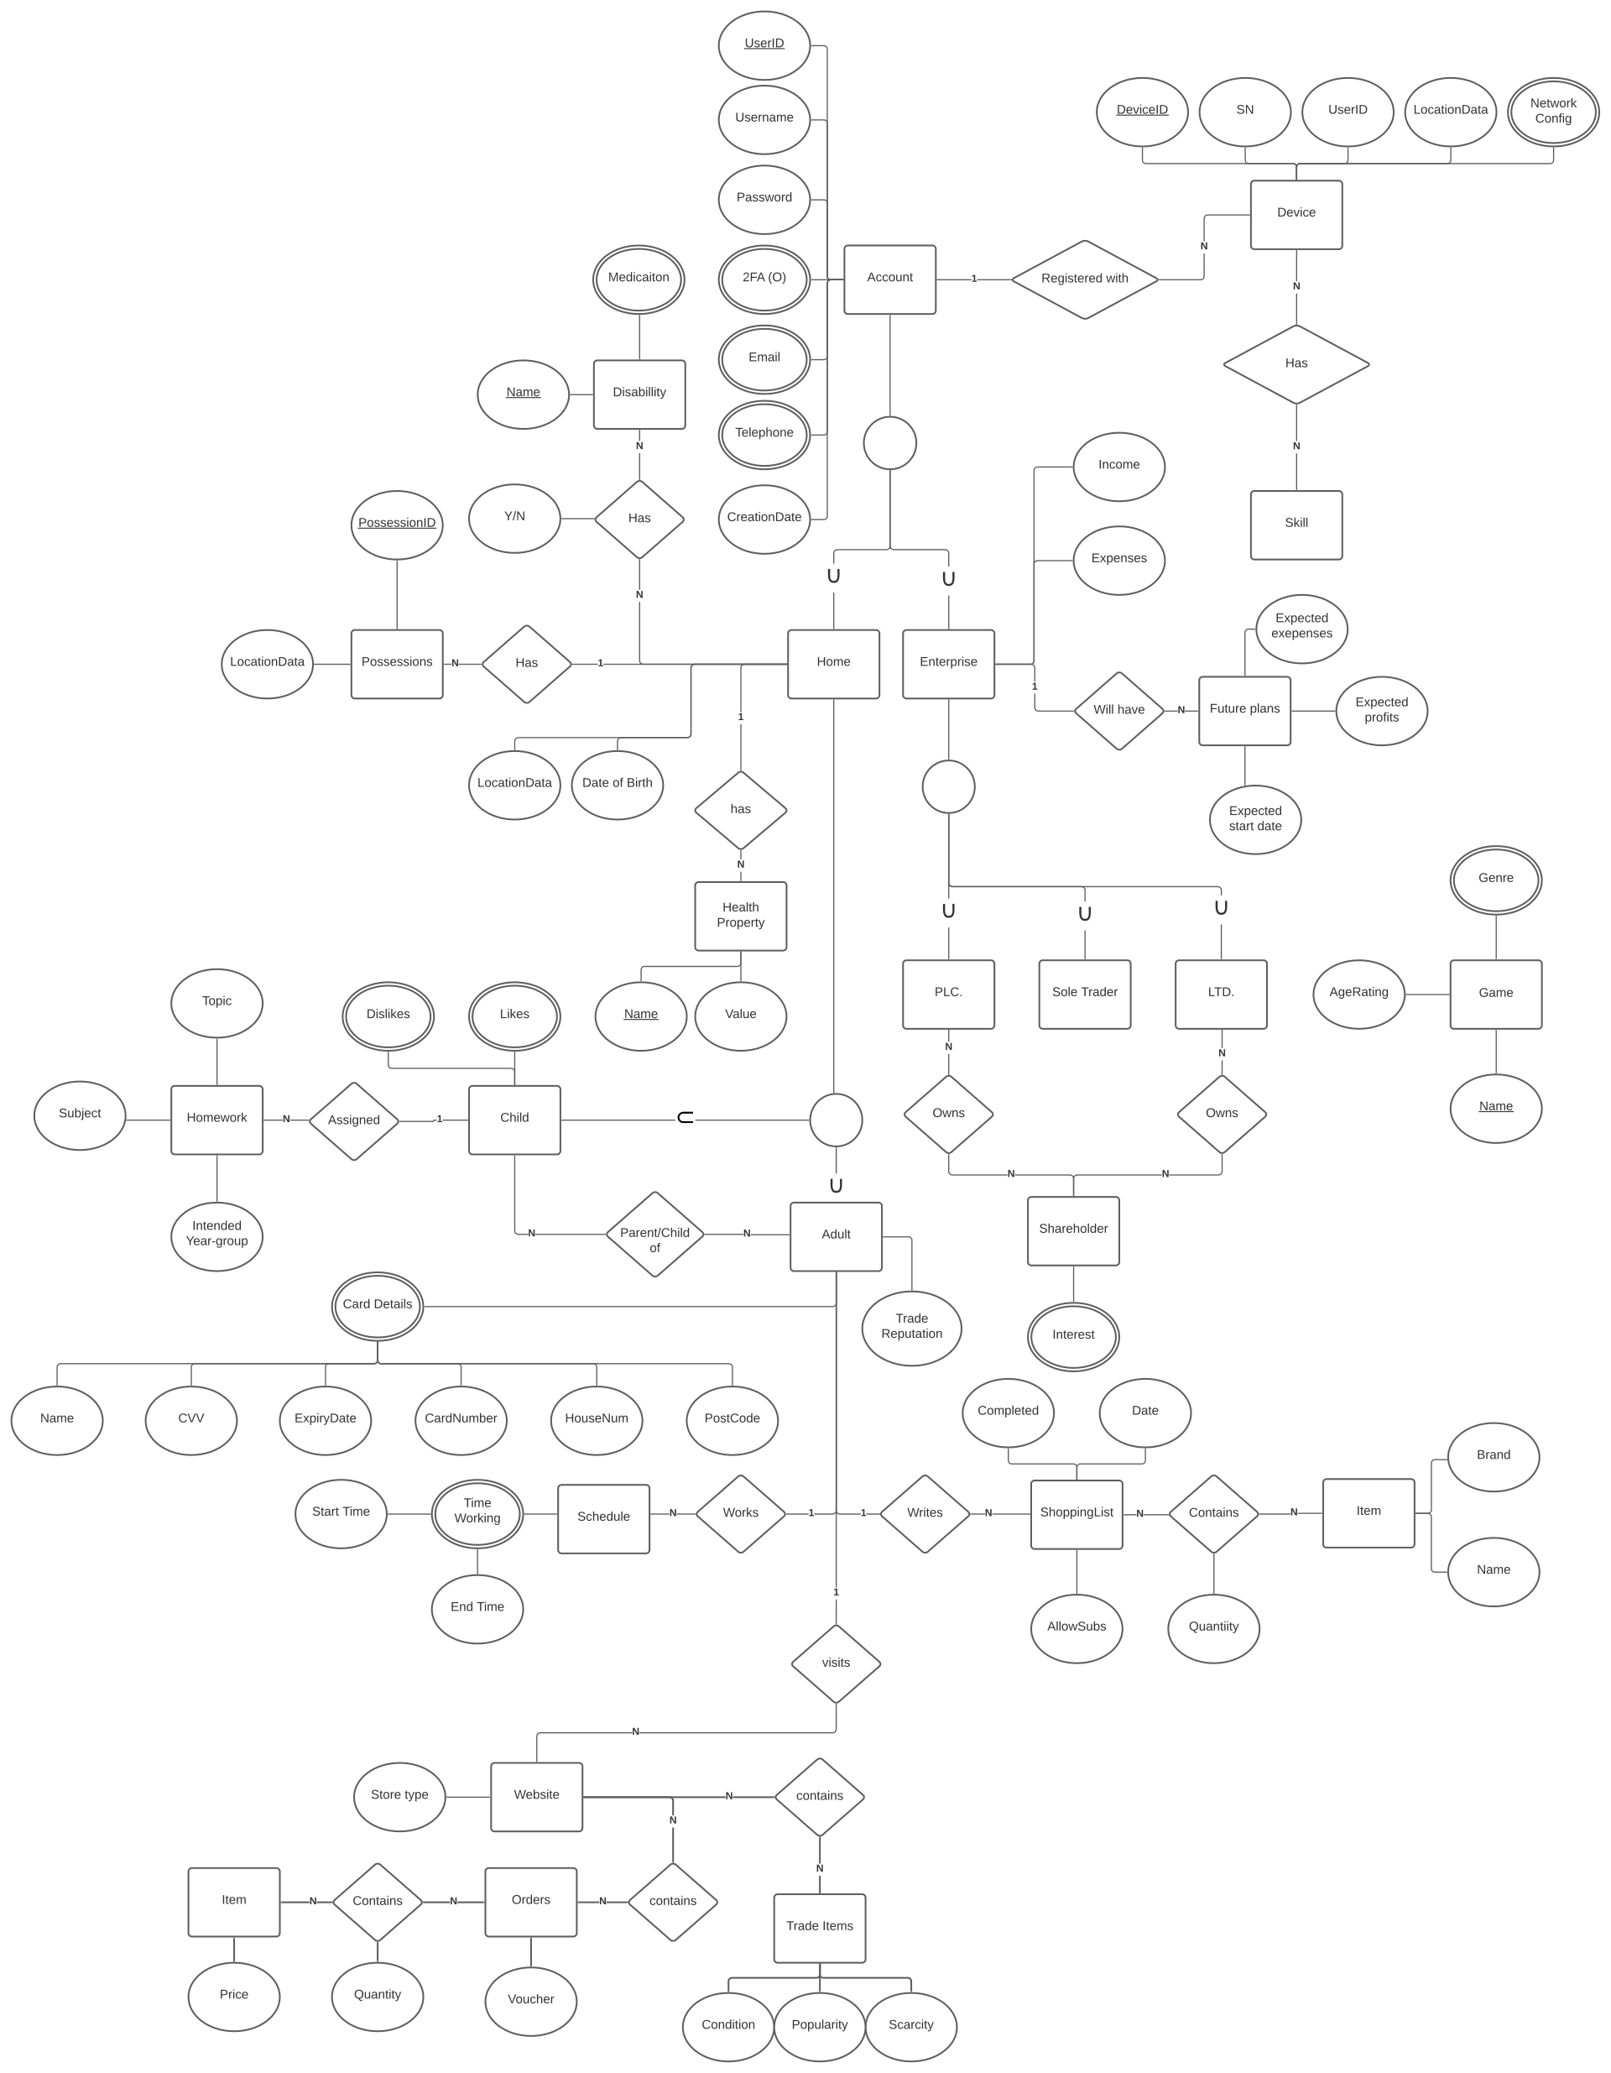
Notes:
As you can see the final ER diagram is pretty huge. We’ll save look at this for later and just show you some key applications for now.

Slide 14
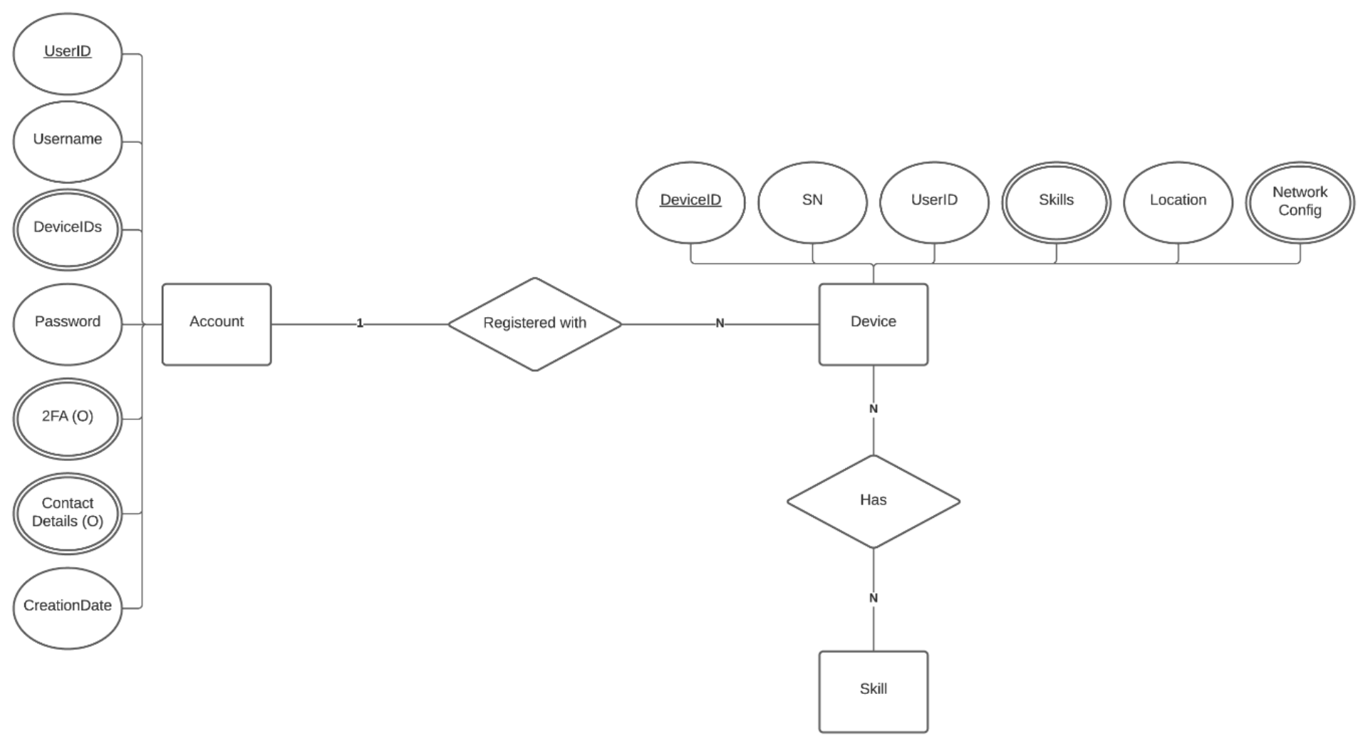
Dictator ER Diagram
Each dictator has an account.
You can give your Leslie assault agents various tactical skills.
Each dictator can have many butler soldiers.

Slide 15
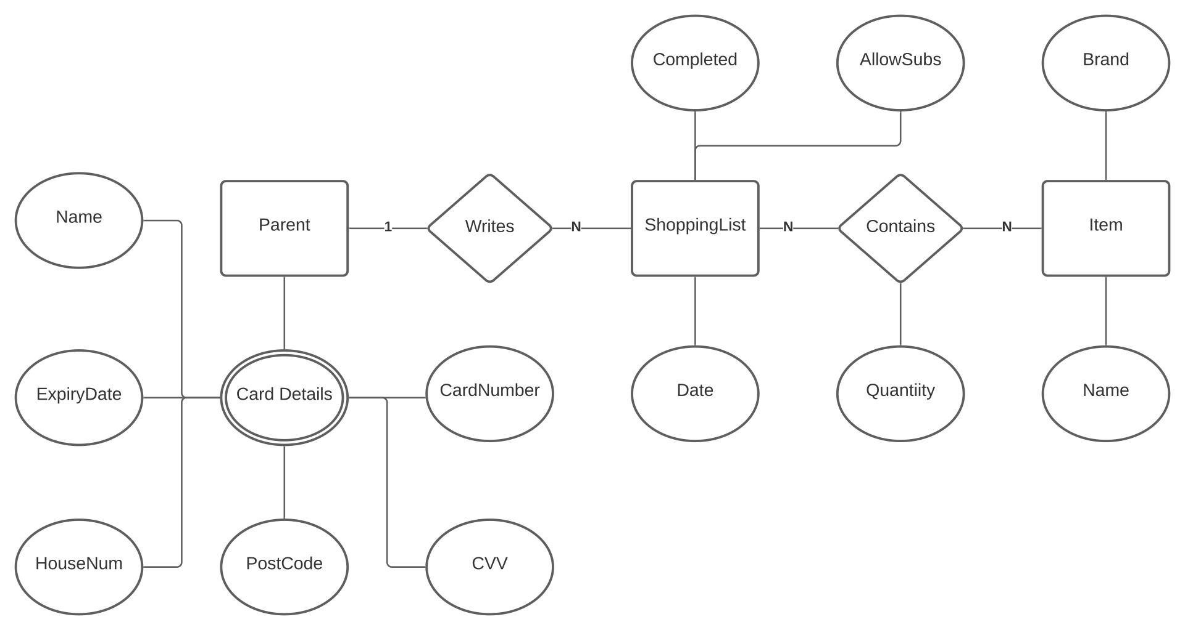
Parent ER Diagram
The parent can have many credit cards.
The parent can have many shopping lists.
Each list contains many items for Leslie to buy.

Slide 16
Healthcare ER Diagram
Each doctor has an account.
You can give your Leslie healthcare assistants various medical skills.
Each doctor can have many Leslies report back on their patients.
Notes:
You can see this ER diagram is just the same one as the dictator. This is shows that the same data mechanisms can be used for multiple purposes. This makes Leslie very extensible and is how he can be generalised for application in many different tasks.

Slide 17





Thanks for watching!

